Slide 1
Developing a New Web Application for the Archive of Formal Proofs
Carlin MacKenzie, S1724780
4th Year Undergraduate Project
Computer Science BSc

Slide 2


Slide 3
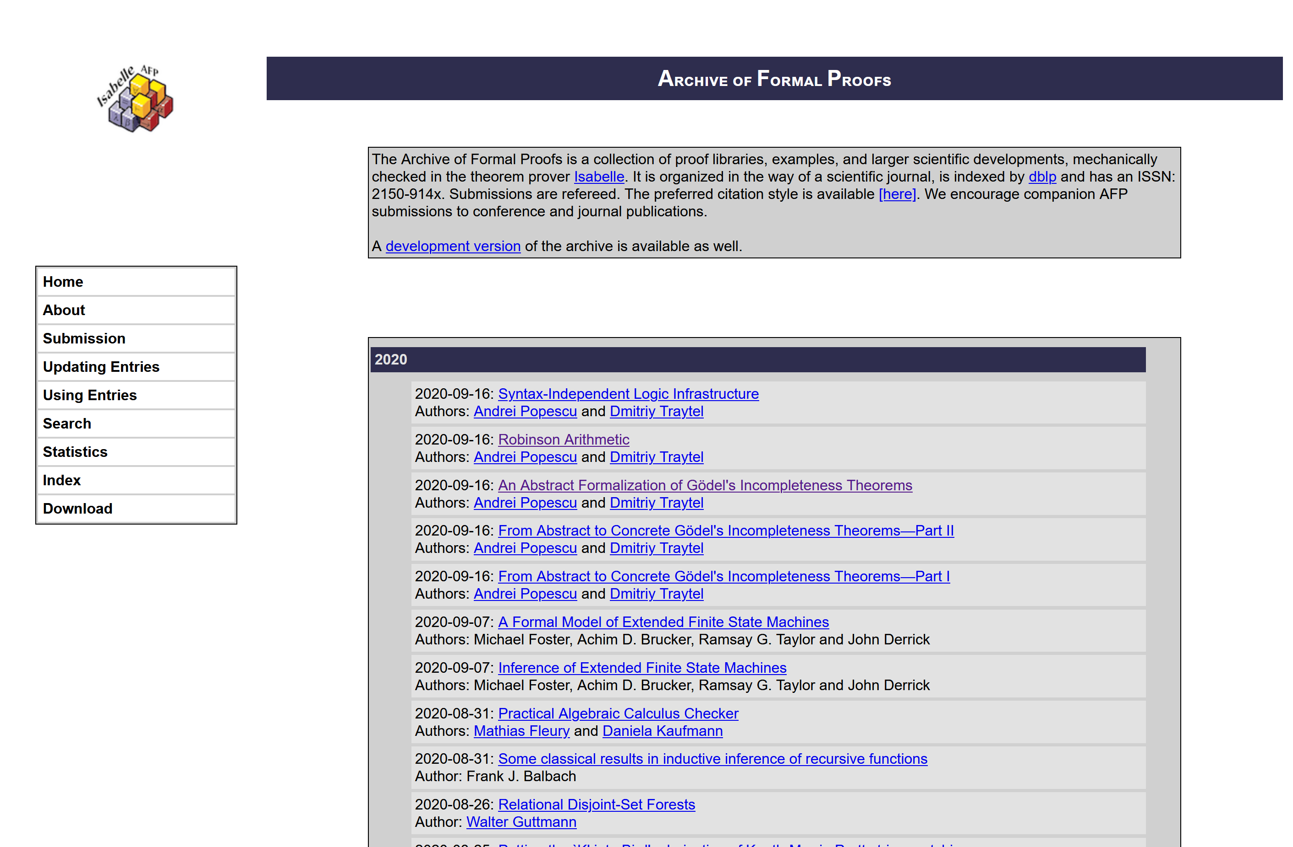

Slide 4
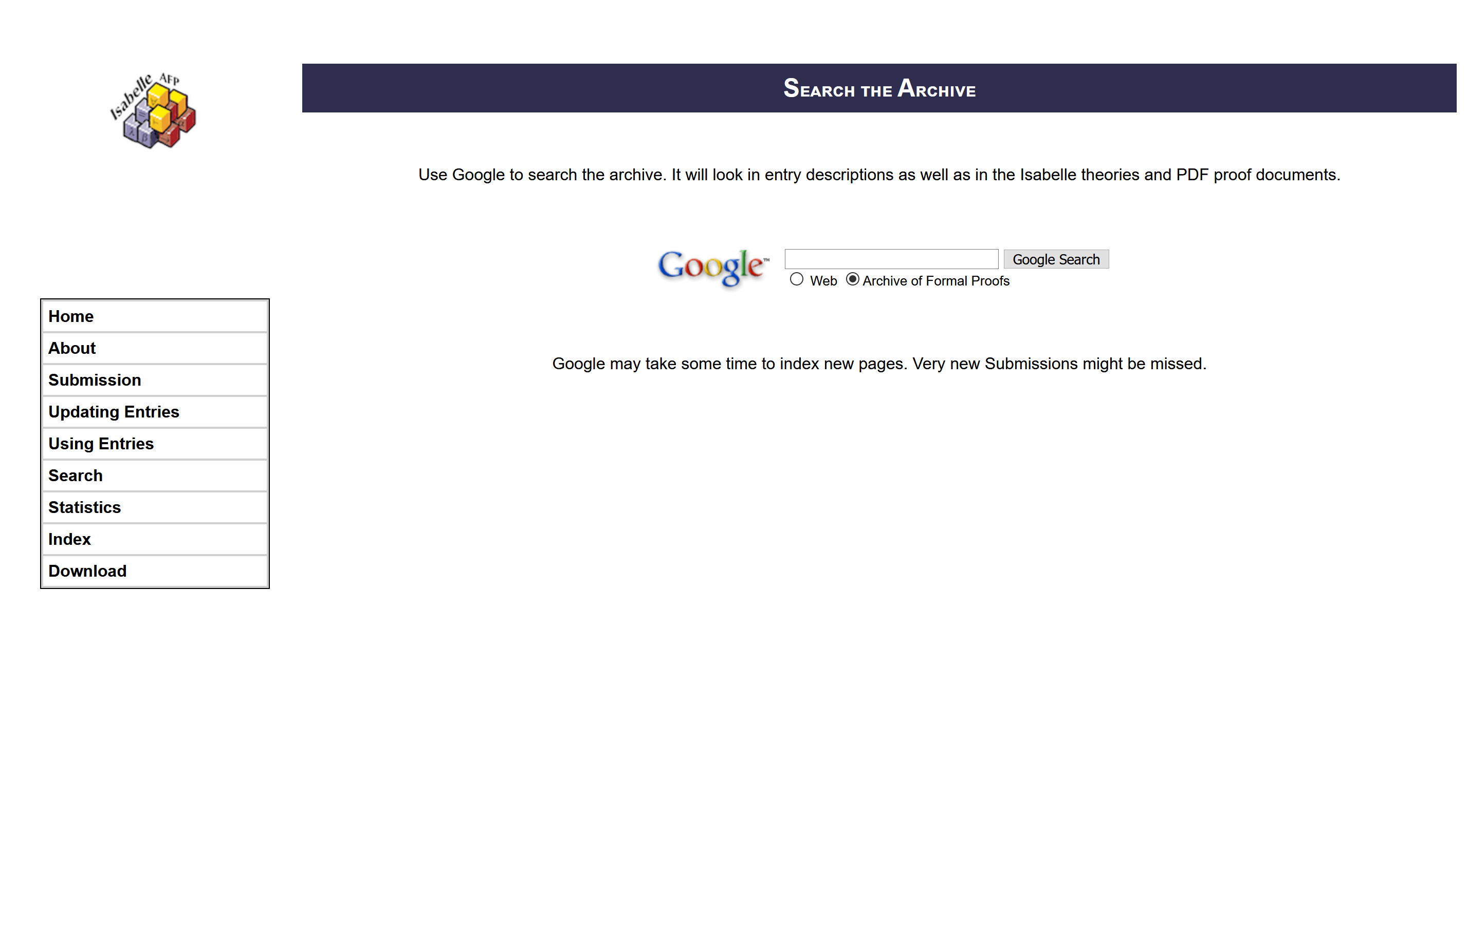

Slide 5
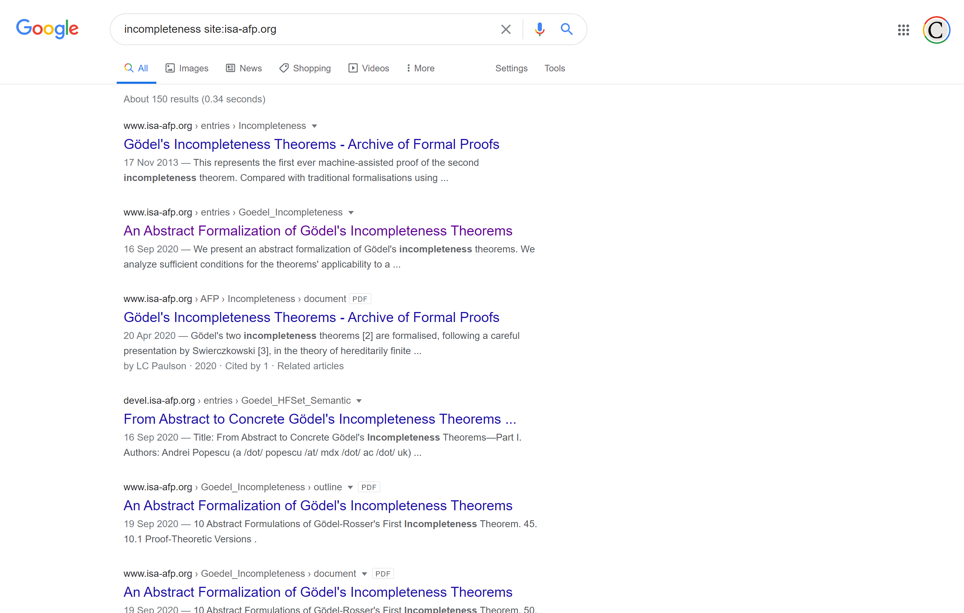

Slide 6
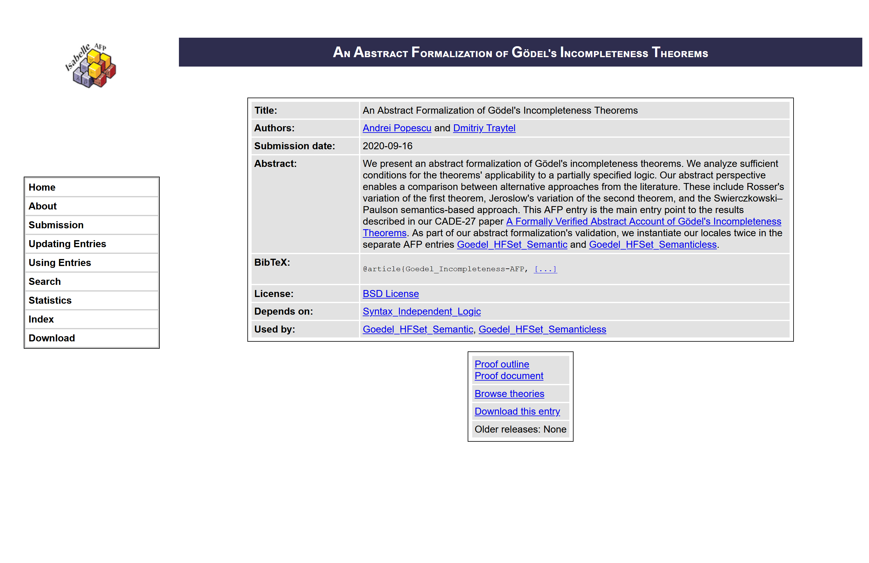

Slide 7
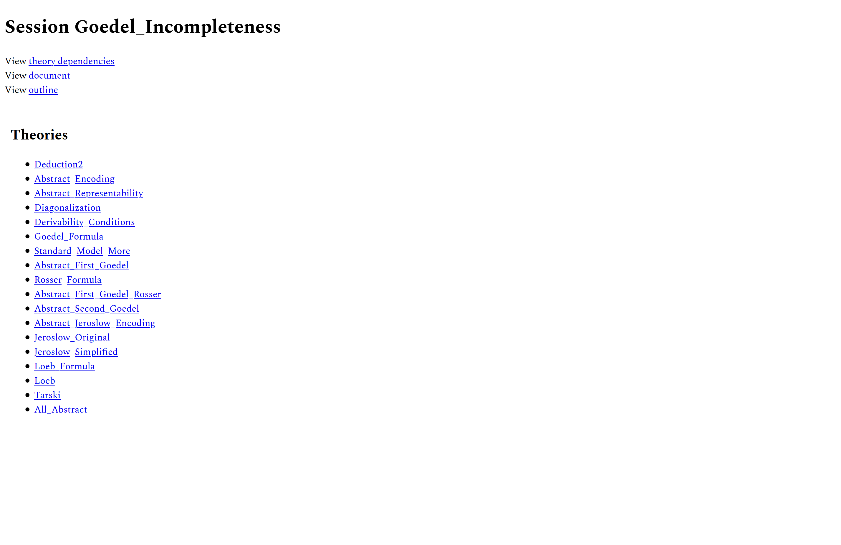

Slide 8
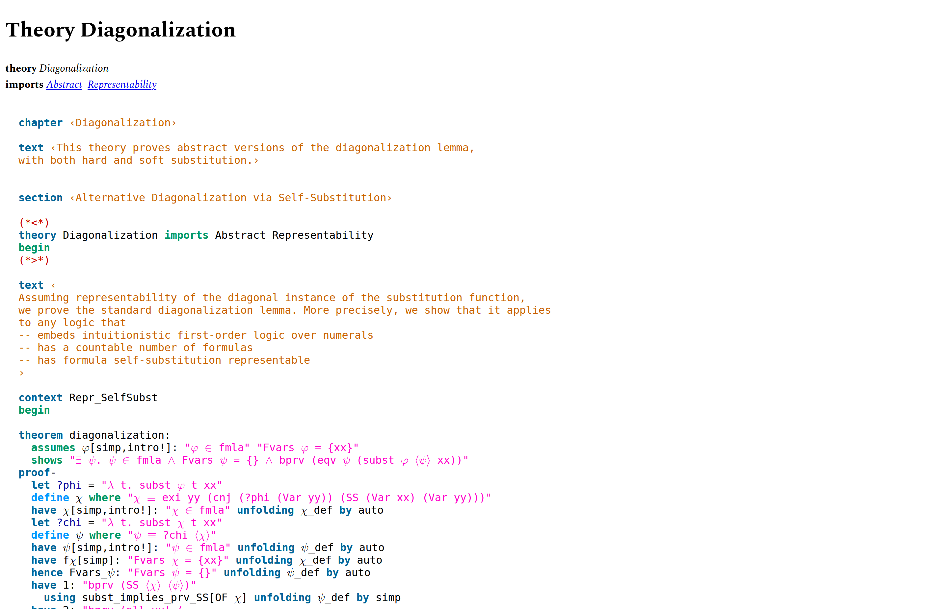

Slide 9
History

Slide 10


Slide 11
🥁🥁🥁

Slide 12
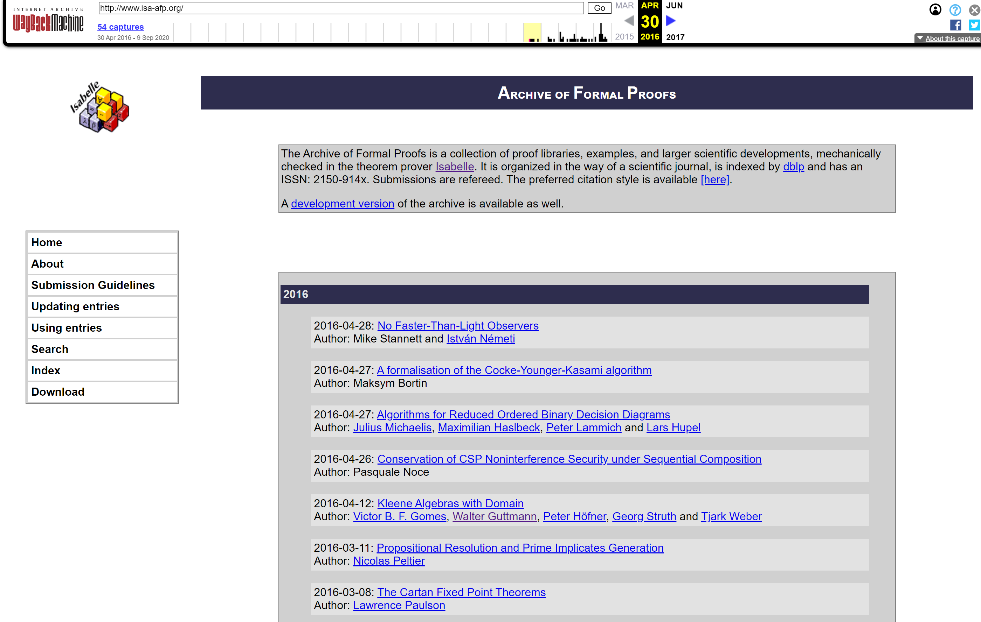

Slide 13
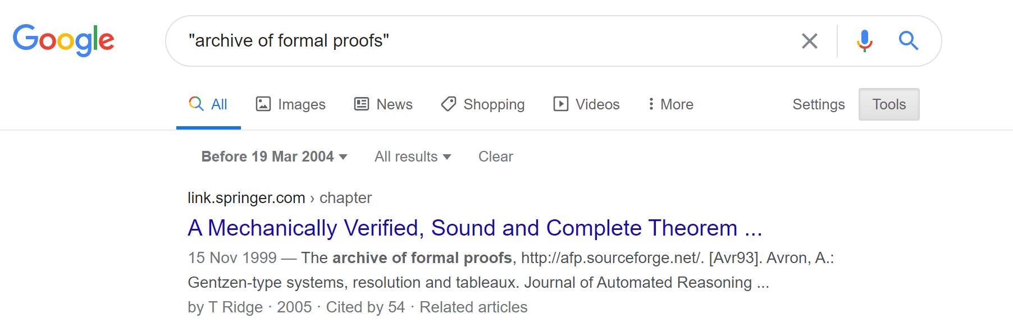
http://afp.sourceforge.net/

Slide 15
🥁🥁🥁

Slide 16
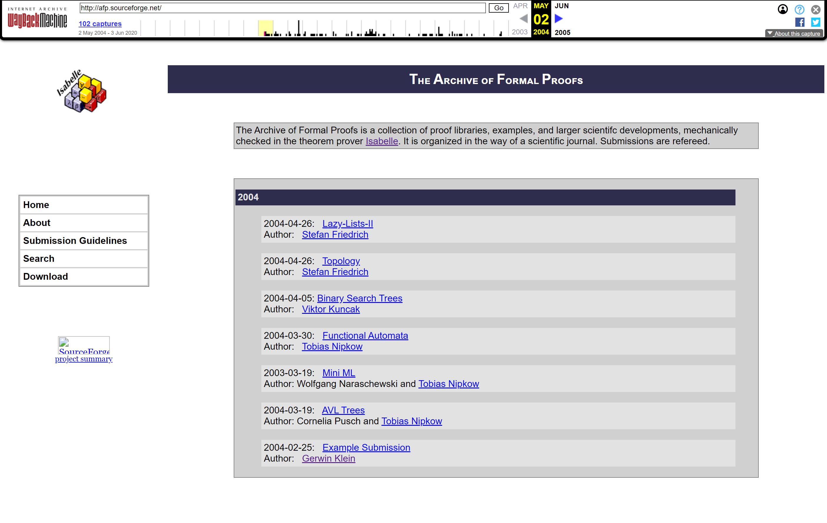

Slide 17
Site generation?
Back to the current AFP…

Slide 18
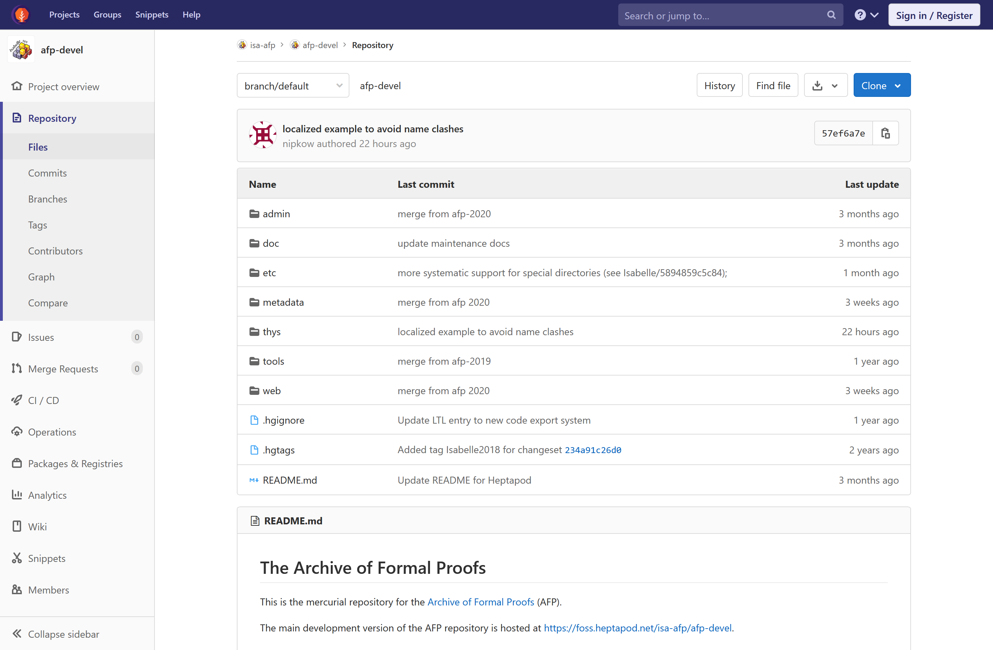

Slide 19
[Arith_Prog_Rel_Primes]
title = Arithmetic progressions and relative primes
author = José Manuel Rodríguez Caballero <https://josephcmac.github.io/>
topic = Mathematics/Number theory
date = 2020-02-01
notify = jose.manuel.rodriguez.caballero@ut.ee
abstract =
This article provides a formalization of the solution obtained by the
author of the Problem “ARITHMETIC PROGRESSIONS” from the
<a href="https://www.ocf.berkeley.edu/~wwu/riddles/putnam.shtml">
Putnam exam problems of 2002</a>. The statement of the problem is
as follows: For which integers <em>n</em> > 1 does the set of positive
integers less than and relatively prime to <em>n</em> constitute an
arithmetic progression?
[Banach_Steinhaus]
title = Banach-Steinhaus Theorem
...
+ 9795 lines

Slide 20
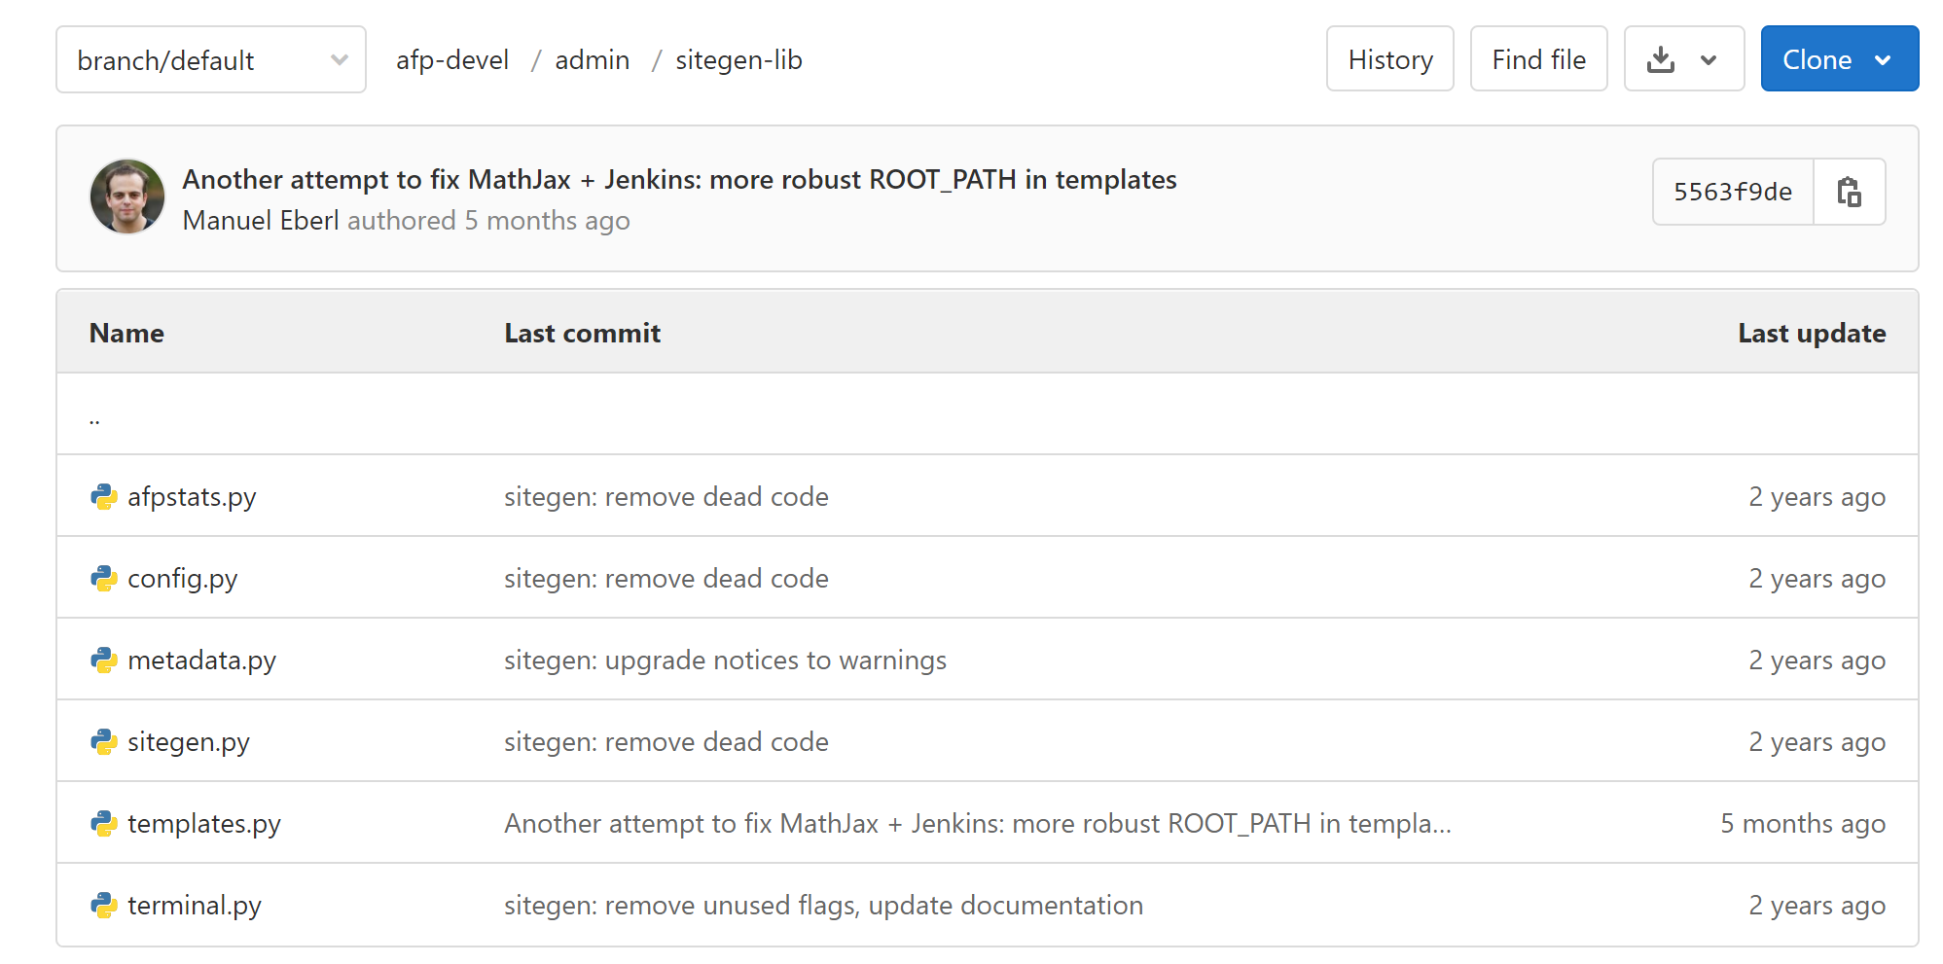
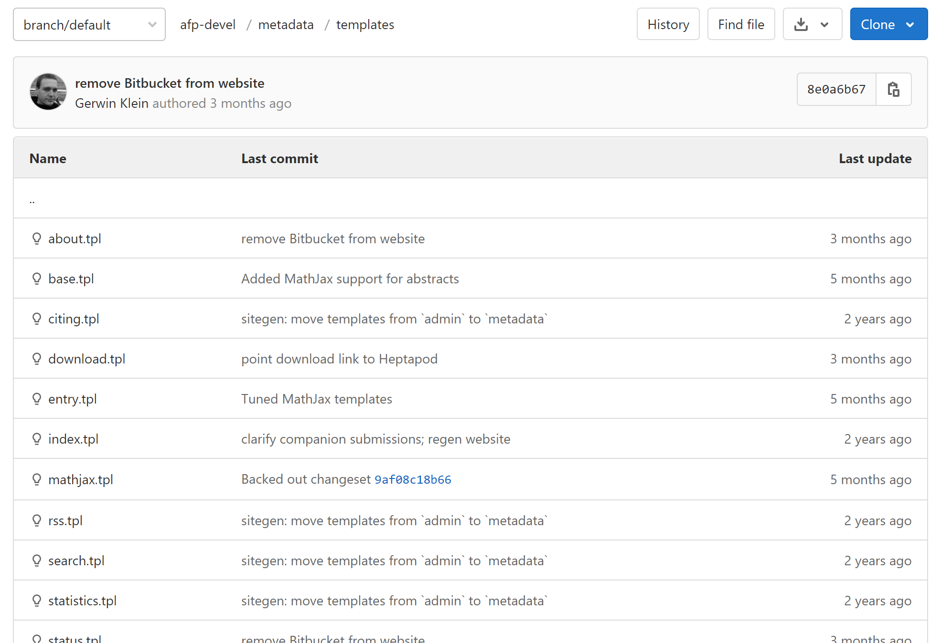
Site generator
Jinja2 Templates

Slide 21
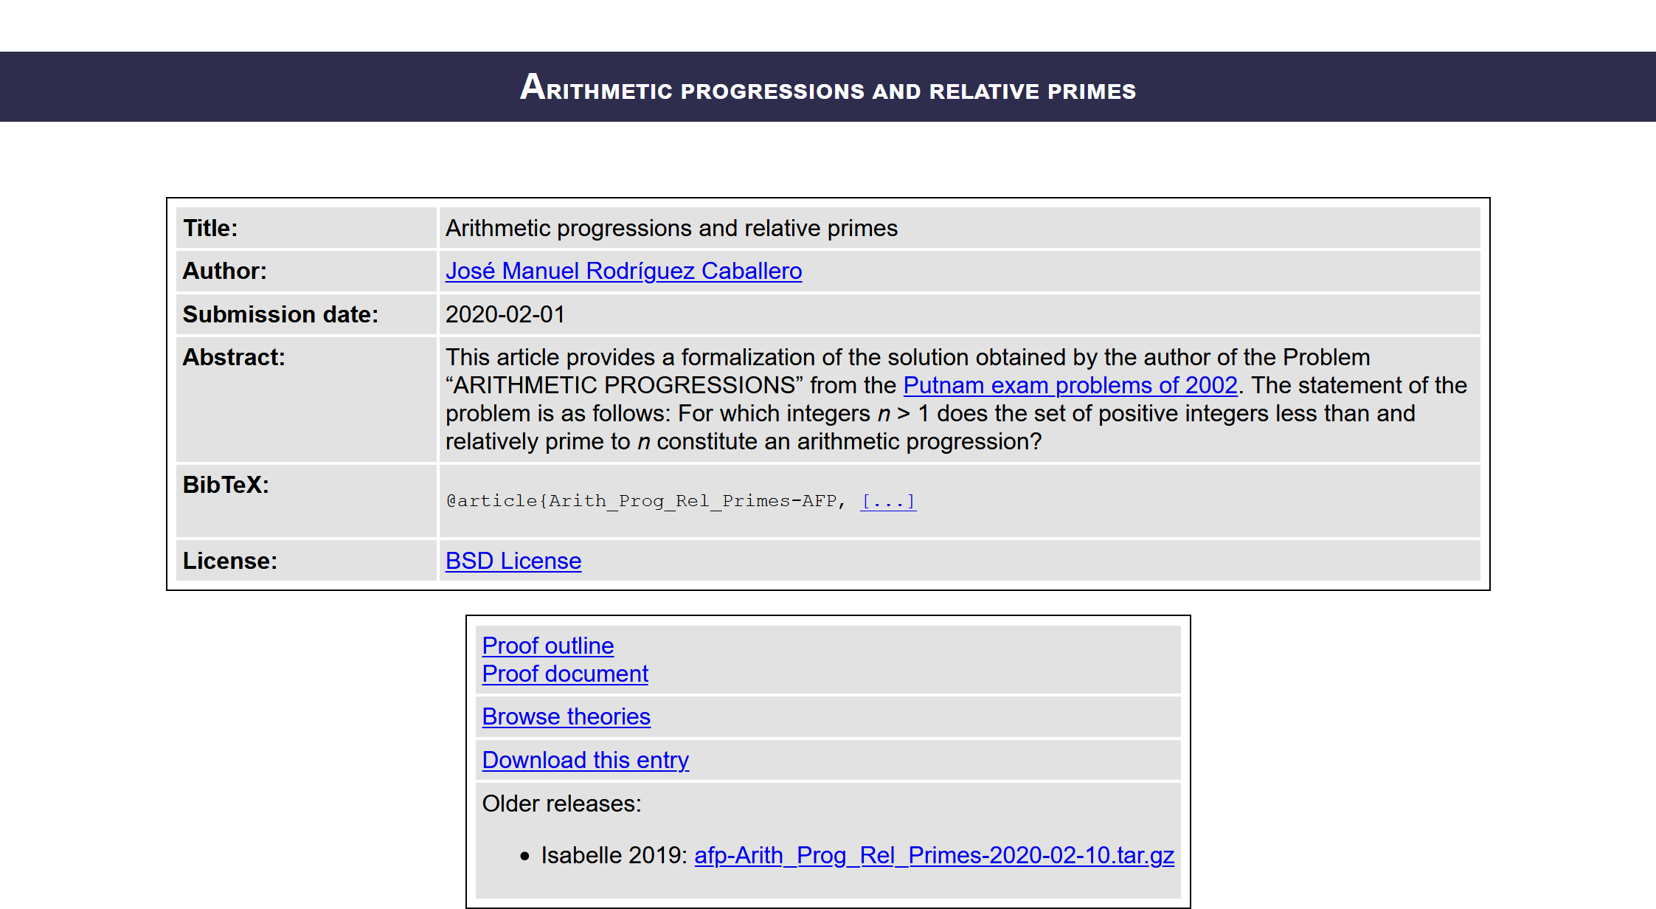



[Arith_Prog_Rel_Primes]
title = Arithmetic progressions and relative primes
author = José Manuel Rodríguez Caballero <https://josephcmac.github.io/>
topic = Mathematics/Number theory
date = 2020-02-01
notify = jose.manuel.rodriguez.caballero@ut.ee
abstract =
This article provides a formalization of the solution obtained by the
author of the Problem “ARITHMETIC PROGRESSIONS” from the
<a href="https://www.ocf.berkeley.edu/~wwu/riddles/putnam.shtml">
Putnam exam problems of 2002</a>. The statement of the problem is
as follows: For which integers <em>n</em> > 1 does the set of positive
integers less than and relatively prime to <em>n</em> constitute an
arithmetic progression?

Slide 22
Revamp the user interface
Improve discoverability
Main objectives
Enhance code browsing
depending on the survey…

Slide 23
But first… site generation?

Slide 24
🥁🥁🥁

Slide 25


Slide 26


Slide 27
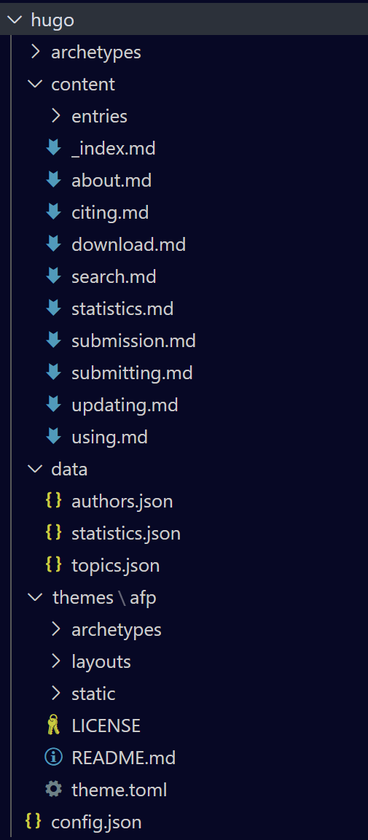

Slide 28
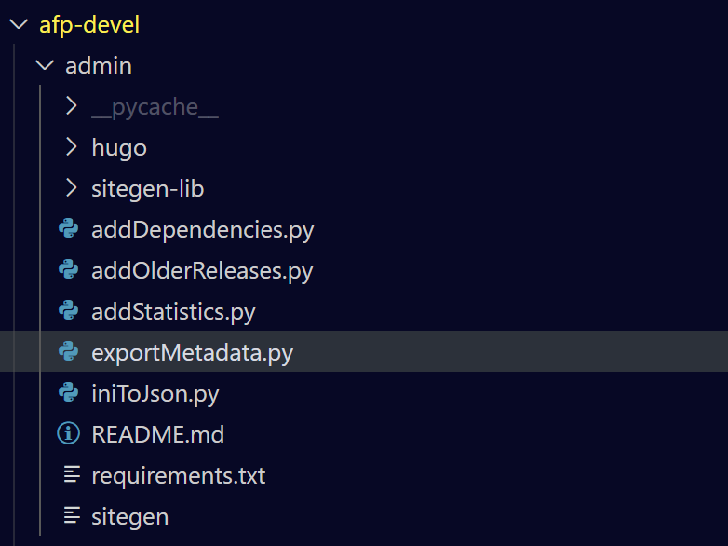

Slide 29
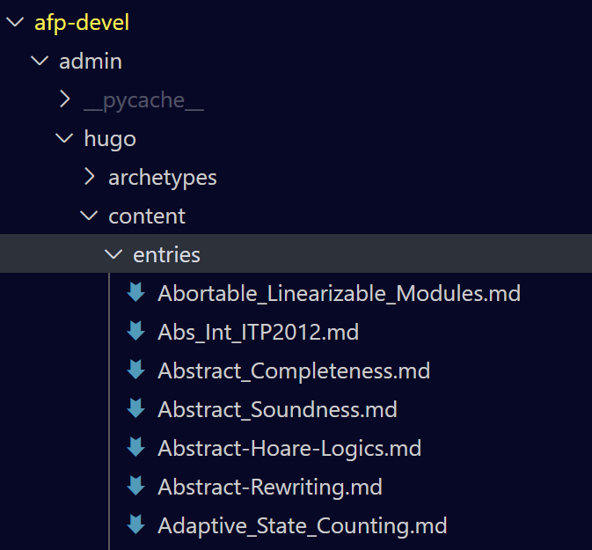

Slide 30
{
"title": "Arithmetic progressions and relative primes",
"authors": [
"José Manuel Rodríguez Caballero"
],
"topics": [
"Mathematics/Number theory"
],
"date": "2020-02-01",
"notify": [
"jose.manuel.rodriguez.caballero@ut.ee"
],
"abstract": "\nThis article provides a formalization of the solution obtained by the\nauthor of the Problem “ARITHMETIC PROGRESSIONS” from the\n<a href=\"https://www.ocf.berkeley.edu/~wwu/riddles/putnam.shtml\">\nPutnam exam problems of 2002</a>. The statement of the problem is\nas follows: For which integers <em>n</em> > 1 does the set of positive\nintegers less than and relatively prime to <em>n</em> constitute an\narithmetic progression?",
"licence": "BSD",
"olderReleases": [
{
"2019": "2020-02-10"
}
]
}

Slide 31










{
"title": "Arithmetic progressions and relative primes",
"authors": [
"José Manuel Rodríguez Caballero"
],
"topics": [
"Mathematics/Number theory"
],
"date": "2020-02-01",
"notify": [
"jose.manuel.rodriguez.caballero@ut.ee"
],
"abstract": "\nThis article provides a formalization of the solution obtained by the\nauthor of the Problem “ARITHMETIC PROGRESSIONS” from the\n<a href=\"https://www.ocf.berkeley.edu/~wwu/riddles/putnam.shtml\">\nPutnam exam problems of 2002</a>. The statement of the problem is\nas follows: For which integers <em>n</em> > 1 does the set of positive\nintegers less than and relatively prime to <em>n</em> constitute an\narithmetic progression?",
"licence": "BSD",
"olderReleases": [
{
"2019": "2020-02-10"
}
]
}

Slide 32
What’s next?

Slide 33
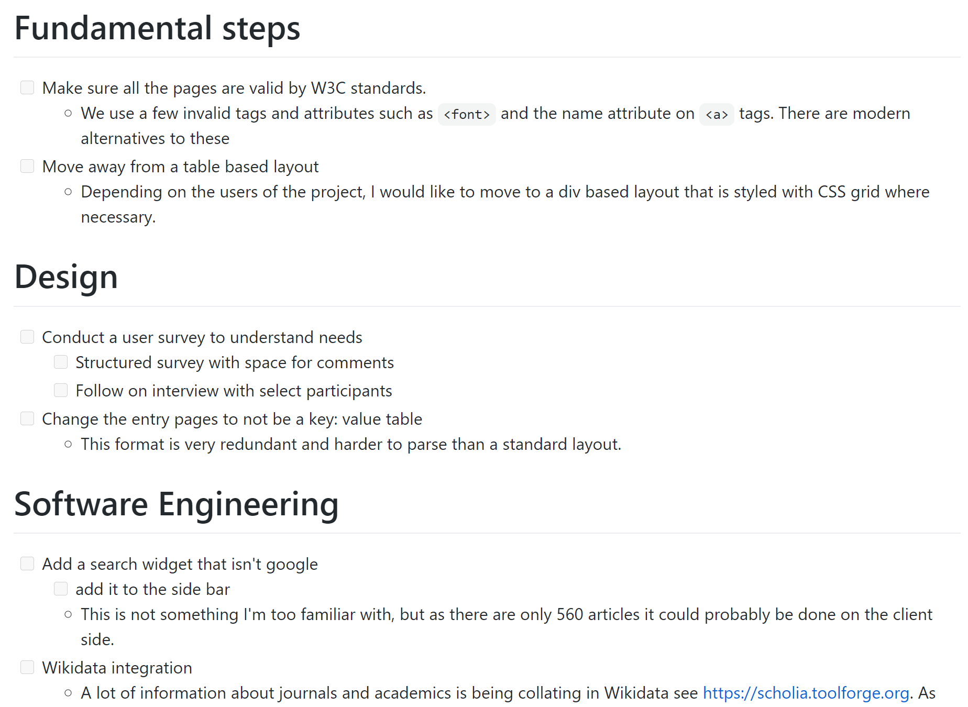
1. Collect survey results
2. Use these to guide
development priorities
3. Develop !

Slide 34
Timeline
Submit
background
chapter
Talk to
upstream AFP?
Do a broader
survey?
Collect
and prioritise
Start report
writing
Report
Submission
Practice project presentations
Now
New years
16/10/20
18/01/21
29/03/21
Start
development

Slide 35
• 3 weeks per priority
• Weekly feedback/touching base
• 11 weeks til new years, so 2 weeks leeway
depending on the survey…

Slide 36
Questions

